Slide 1

Designing websites
Lesson 3: Hyperlinks and navigation

Slide 2
Objectives
In this lesson, you will learn how to:
link to an external web page
link pages of a website together
use an image as a clickable hyperlink
create and style a navigation bar.

Slide 3
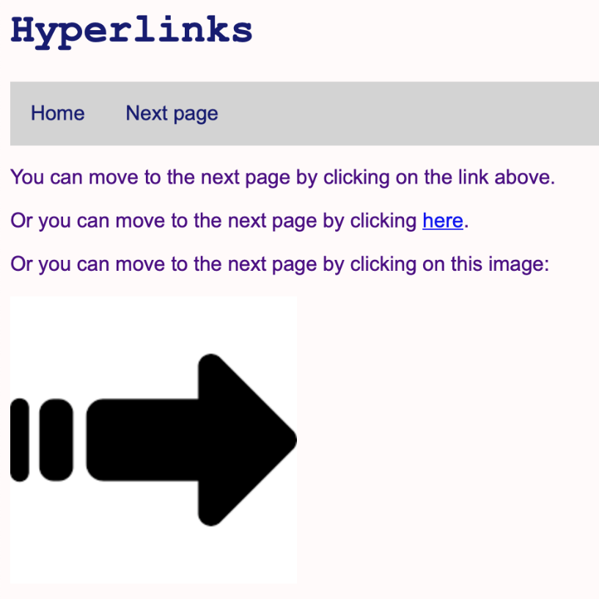

Slide 4
HTML hyperlinks
Hyperlinks are found on nearly all web pages. They allow users to move from page to page within a website, or to move to a page on another website.
The anchor tag <a> is used to define a hyperlink, which links one web page to another.
The hyperlink reference attribute href is used to identify the destination that the hyperlink will take you to. If this is an external web page, you need to give the full URL.
The link text is what is shown on the screen. When the mouse moves over this text, the mouse pointer turns into a hand. Clicking on the link text takes you to the linked page.

Slide 5
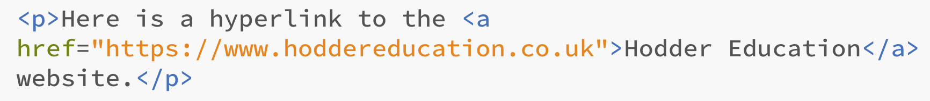
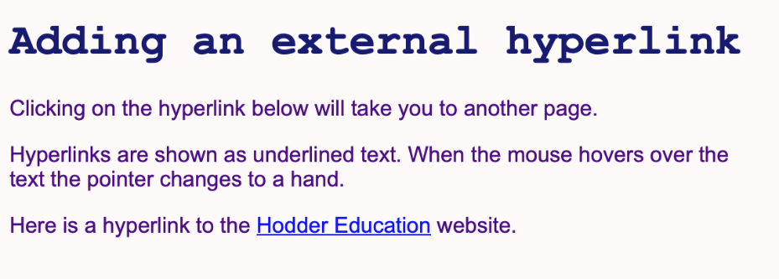
Here is an example of a hyperlink included within a sentence in an HTML document:
This is how the code above is displayed by the browser:
Watch Video 3.1

Slide 6

Activity 3.1: Adding an external hyperlink

Slide 7
The target attribute
When a user clicks on a hyperlink, the linked page will replace the one currently displayed in the browser window.
This is ideal when moving from page to page within a website.
However, if the hyperlink is to an external web page, it is often preferable for this to open in a new browser window.
This is done by adding target="_blank" after the href.
For example:
Watch Video 3.2

Slide 8
Activity 3.2: Opening the linked web page in a new window

Slide 9
Naming web pages and adding internal hyperlinks
The default name for the home or start page of a website is index.html.
Other pages are usually given a name that is the same as, or very similar to, the title of the page. Page names must:
only use lower case letters
contain no spaces, punctuation or symbols (although dashes may be used for spaces)
be as short as possible, using keywords that make it clear what the page is about.
For example: biscuit-recipes.html or footballers.html.
An internal hyperlink, a link to a page on the same website, is created in exactly the same way as an external hyperlink, but the file name of the page is used instead of the full URL.
Watch Video 3.3

Slide 10
Activity 3.3: Adding an internal hyperlink

Slide 11
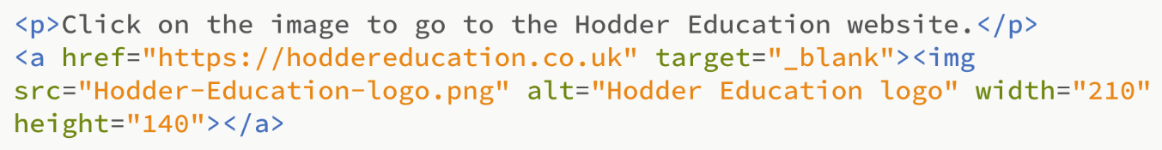
Using an image as a clickable hyperlink
To use an image as a hyperlink, replace the link text with the <img> tag containing the src, alt, width and height attributes of the image.
For example:
Watch Video 3.4

Slide 12
Activity 3.4: Using an image as a clickable hyperlink

Slide 13
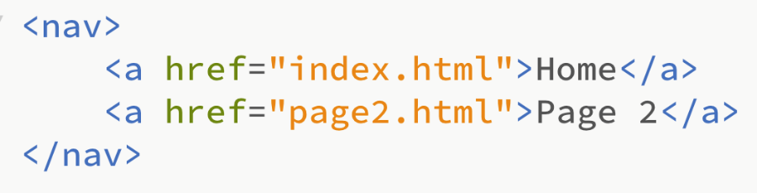
Creating a navigation bar
A navigation bar is essentially a set of hyperlinks, but by adding formatting it is possible to make a website look much more professional.
The <nav> tag should be used to create a series of navigation links, with the individual hyperlinks defined in the usual way using the anchor tag <a>.
For example:

Slide 14
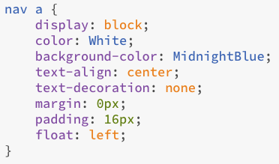
Styling a navigation bar
Styling is applied via the style sheet to all <a> elements within the <nav> tag.
For example:
display: block; creates a block around each hyperlink, with the whole block clickable, not just the text.
color, background-color and text-align are used to control the text colour, background colour and text alignment.
text-decoration: none; removes the underlining that is normally added to a hyperlink.
margin: 0; ensures that the hyperlinks are displayed starting at the left-hand edge of the page.
padding: 16px; adds some padding around each hyperlink so that they are spaced appropriately. The amount of padding can be adjusted.
float: left; ensures that the hyperlinks appear next to each other.

Slide 15

Styling a navigation bar
We can also add styling to the nav tag itself.
To make the links appear side-by-side in a row we use display: flex. This creates a flexible container, that the hyperlinks are placed inside in a row.
Adding the same background colour for the container as you have used for the hyperlinks ensures the navigation bar fills the width of the page.
For example:

Slide 16

Styling a navigation bar
To make the navigation bar look even more professional, it is possible to change the background colour and/or text colour of a hyperlink when the mouse hovers over it.
For example:
Watch Video 3.5

Slide 17
Activity 3.5: Creating and styling a navigation bar

Slide 18
Quiz 3

